Slide 1
KIVA Introduction NETLOGO
Rasyid Fajar
17 December 2020
Industrial Management Department
Center for Internet of Things Innovation
National Taiwan University of Science and Technology

Slide 2
Check Points

Slide 3
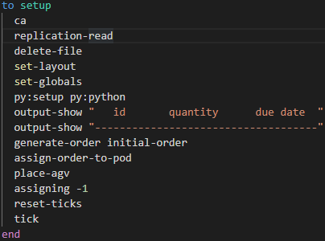

SETUP
CODE
FUNCTION
Initialize the program
PROCESS FLOW
Go
Replication-read
Delete-file
Py:setup
Set globals
Set-layout
CODE EXPLANATION
Output-show
Generate-order
Assign-order-to-pod
ca: clear all
Call subfunction:
replication-read, delete-file, set-layout, set-globals
py:setup py:python: initialize python extension
output-show: Print something
Call subfunction:
generate-order, assign-order-to-pod, place-agv, assigning
reset-ticks: reset ticks to 0
tick: increase 1 tick
Reset-ticks
assigning
Place-agv
ticks
End

Slide 4

Replication-read
CODE
FUNCTION
Initialize replication value
CODE EXPLANATION
Try:
csv:from-file “Replication.csv”: open file “Replication.csv”
Create variable rep_item and set the value to the first item of the csv file
Set variable replication to the first item of rep_item
Except:
Set replication to 0
DICTIONARY
carefully: carefully [ commands1 ] [ commands2 ]
let : let variable value
item : item index list
item index string
set : set variable value
ADDITIONAL FILES
CSV
Replication.csv: Read the value of replication

Slide 5
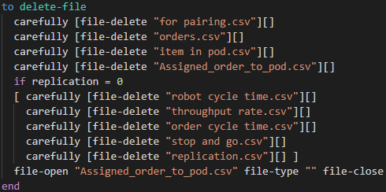
Delete-file
CODE
FUNCTION
Delete opened file
CODE EXPLANATION
Try to delete for pairing.csv, orders.csv, item in pod.csv, Assigned_order_to_pod.csv
If replication 0:
Try to delete robot cycle time.csv, throughput.csv, order cycle time.csv, stop and go.csv, replication.csv
Open file Assigned_order_to_pod.csv
Write empty value to Assigned_order_to_pod.csv
Close the Assigned_order_to_pod.csv
DICTIONARY
file-delete: file-delete string
file-type: file-type value
if: if boolean [ commands ]
file-open: file-open string
file-close: file-close

Slide 6
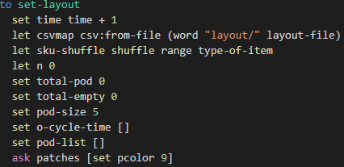
set-layout
CODE
FUNCTION
Initialize patches
CODE EXPLANATION
Open layout file from csv file
Create an array of integer with value form 0 to type-of-item and shuffle the order
Initialize some variable
Set all patches color to 9
DICTIONARY
word : word value1 value2
(word value1 ...)
range : range stop
(range start stop)
(range start stop step)
shuffle: shuffle list
ask : ask agentset [commands]
ask agent [commands]
ADDITIONAL FILES
CSV
csvmap: Read the value for each patch

Slide 7
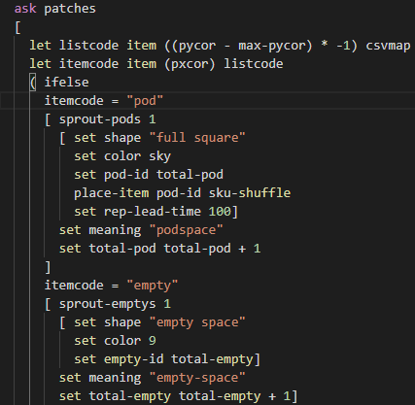
set-layout
CODE
FUNCTION
Initialize patches
CODE EXPLANATION
Iterate over patches
Check the value in current coordinate
Ifelse:
Current item is pod:
create new pod
set the shape, color, and id of the patch
Call Sub-Function: place-item
set the meaning of the patch
increment the total-pod variable
Current item is empty:
set current patch to empty
DICTIONARY
ifelse : ifelse boolean1 [ commands1 ] [ elsecommands ]
(ifelse boolean1 [ commands1 ] boolean2 [commands2 ] ... [ elsecommands ])
sprout : sprout number [ commands ]
sprout-<breeds> number [ commands ]

Slide 8
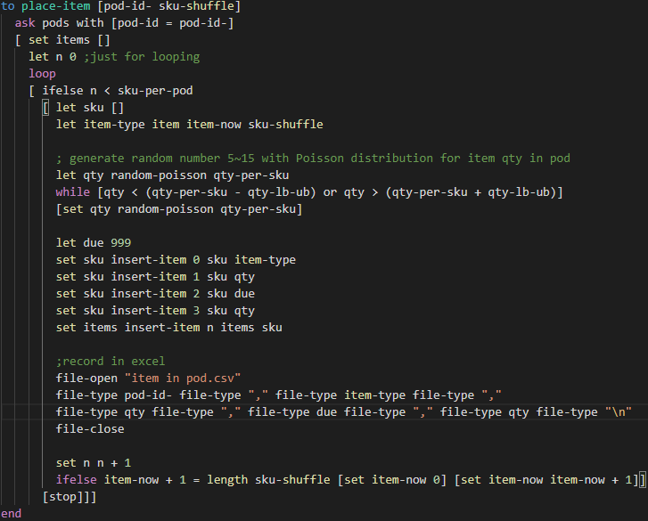
Place-item
CODE
SUBFUNCTION
Place items in a pod
CODE EXPLANATION
Ask pod with specific id
Loop sku-per-pod times
get item-now th index of sku-shuffle
generate random number 5~15 with Poisson distribution for item qty in pod
insert item-type, qty, due, and qty into sku
insert sku into items
open file “itemin pod.csv”
write pod-id, item-type, qty, due, and qty into the file
close file
iterate loop
iterate item-now and set item-now to 0 if item-now equal to length of sku-shuffle

Slide 9
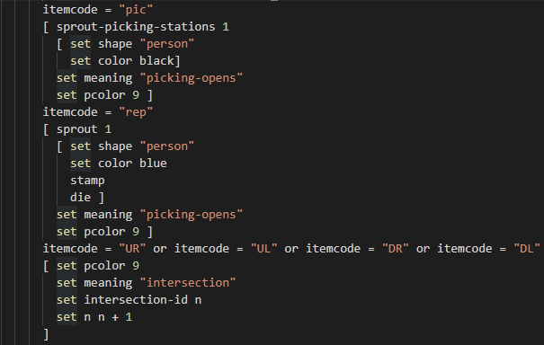
set-layout
CODE
FUNCTION
Initialize patches
CODE EXPLANATION
Still iterating over patches like previous slide
Still ifelse from previous slide:
Current item is pic:
set current patch to picking station
Current item is rep:
set current patch to replenishment station
stamp to draw the shape in the drawing
die to erase the turtle
DICTIONARY
stamp : stamp
die : die

Slide 10
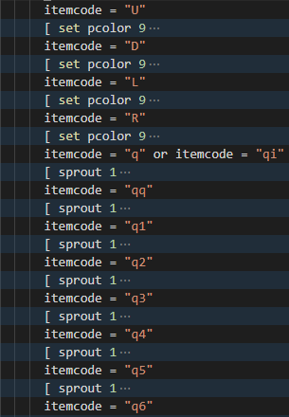
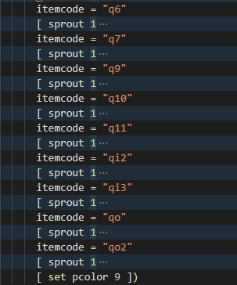
set-layout
CODE
FUNCTION
Initialize patches
CODE EXPLANATION
Still iterating over patches like previous slide
Still ifelse from previous slide:
set current patch to corresponding desired value

Slide 11

set-layout
CODE
CODE EXPLANATION
Get the distance between picking station to entering queue
Set entering-queue position for all picking-station
Erase all turtles with shape equal to “int7”
DICTIONARY
sort : sort list
sort agentset
of : [reporter] of agent
[reporter] of agentset
with : agentset with [reporter]

Slide 12
Thank You
Rasyid
Industrial Management Department
Center for Internet of Things Innovation
National Taiwan University of Science and Technology

